Slide 1
Statistically Attractive: Making Data Look Good with R
Abraham Arbelaez

Slide 2
Introduction
Welcome! If you’ve ever made a plot so ugly it hurt your feelings — today’s your redemption arc.

Slide 3

Introduction

Slide 4
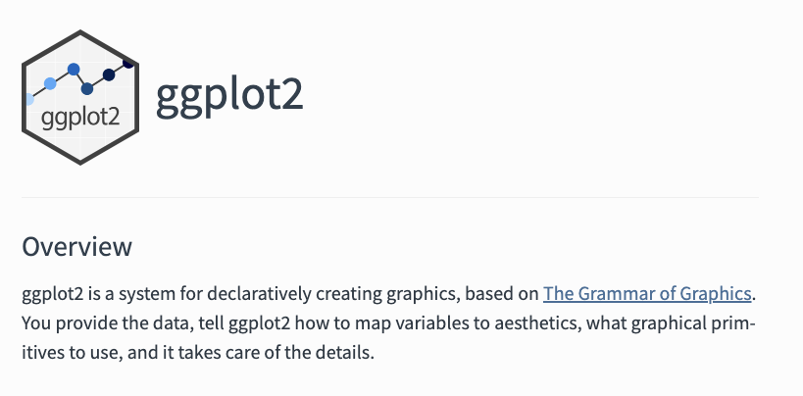
Ggplot2

Slide 5
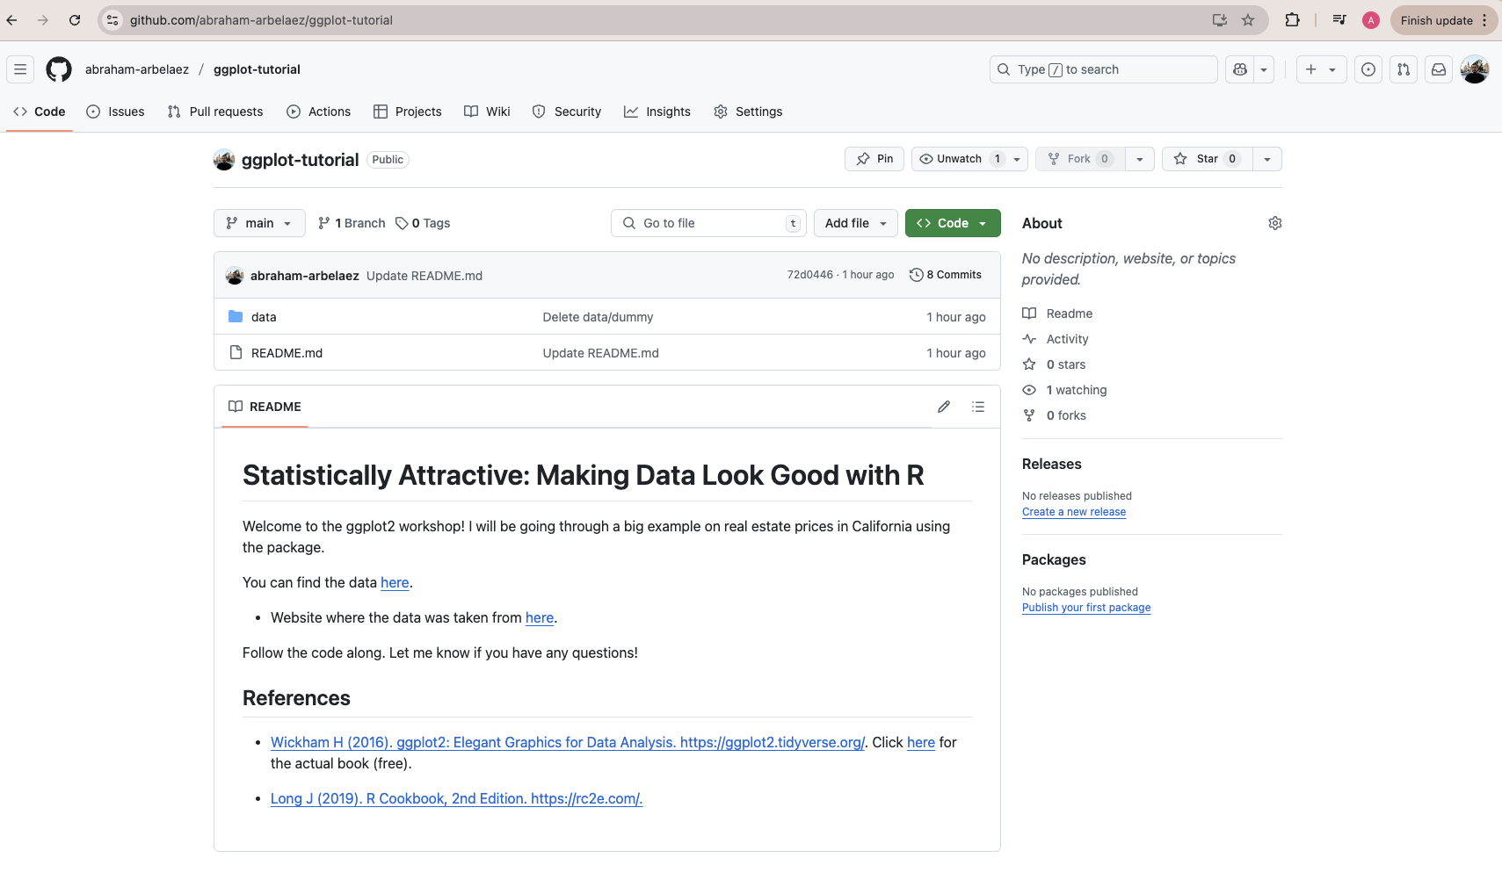
Before we get started!

Slide 6
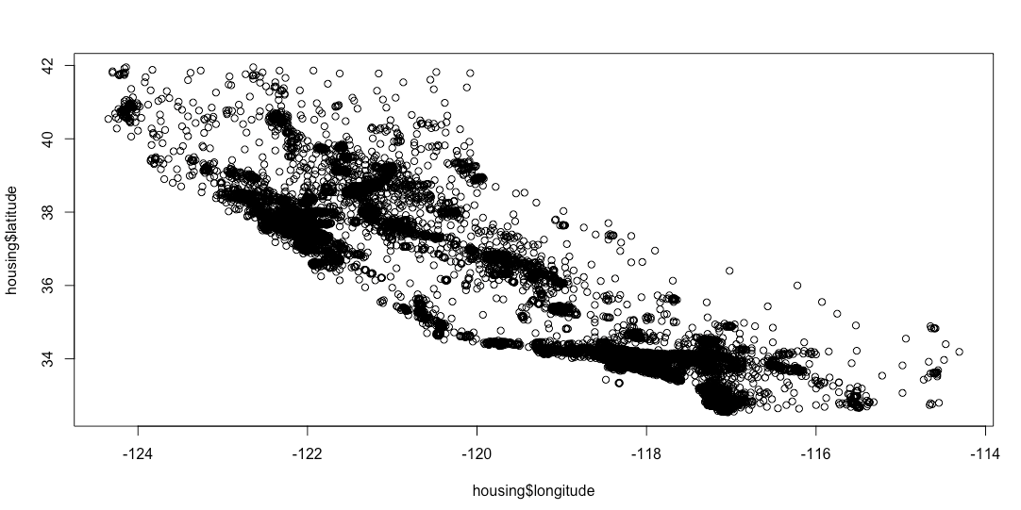
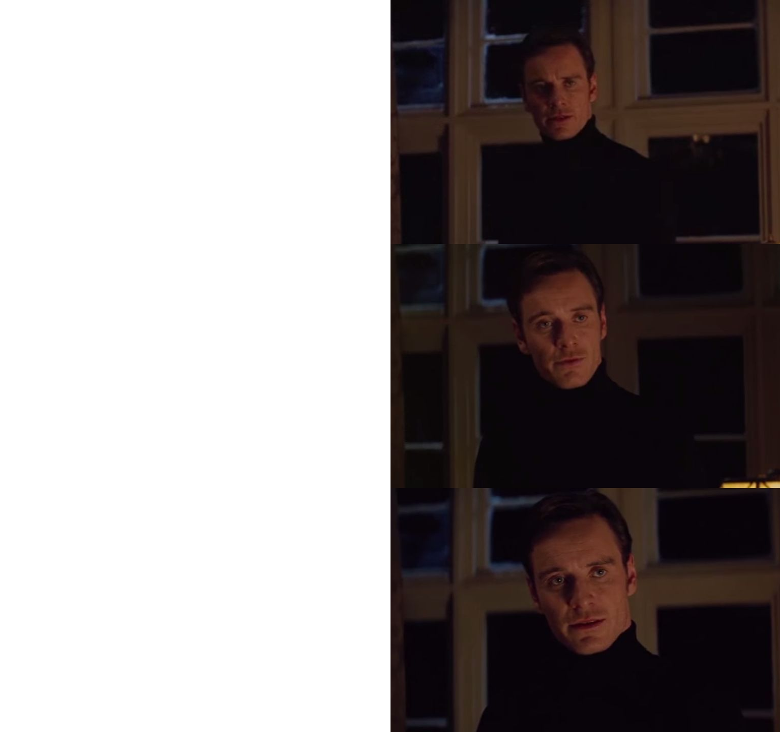
Let’s plot
Show me a nice plot

Slide 7
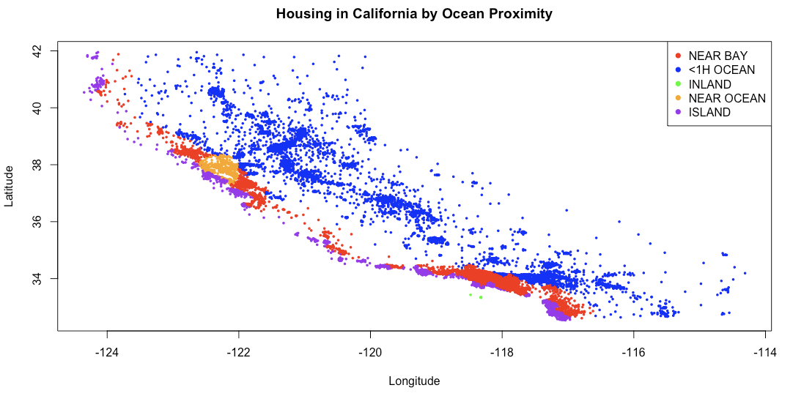
Let’s plot
Show me a nice plot
I said…
Show me a nice plot

Slide 8
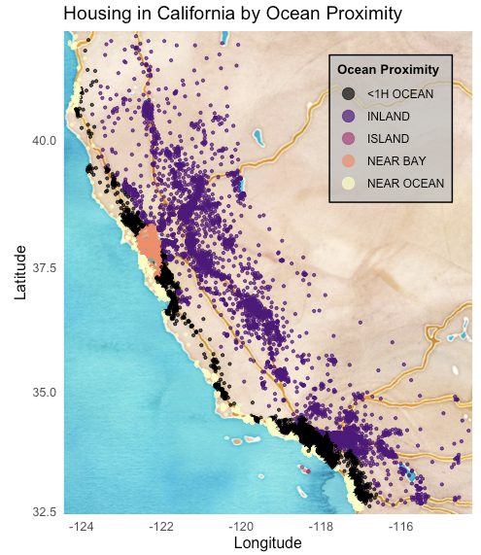
Let’s plot
Show me a nice plot
I said…
Show me a nice plot
Perfection.

Slide 9
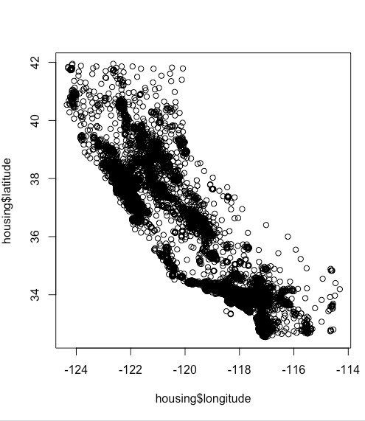
Differences…

Slide 10
Differences…

Slide 11
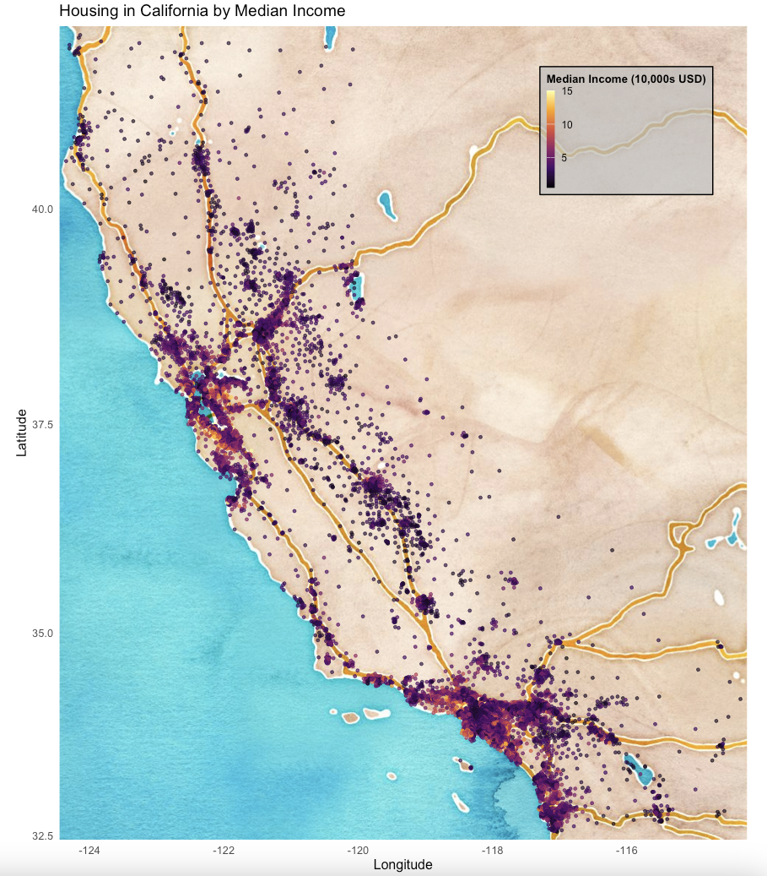
Housing in California by Median Income

Slide 12
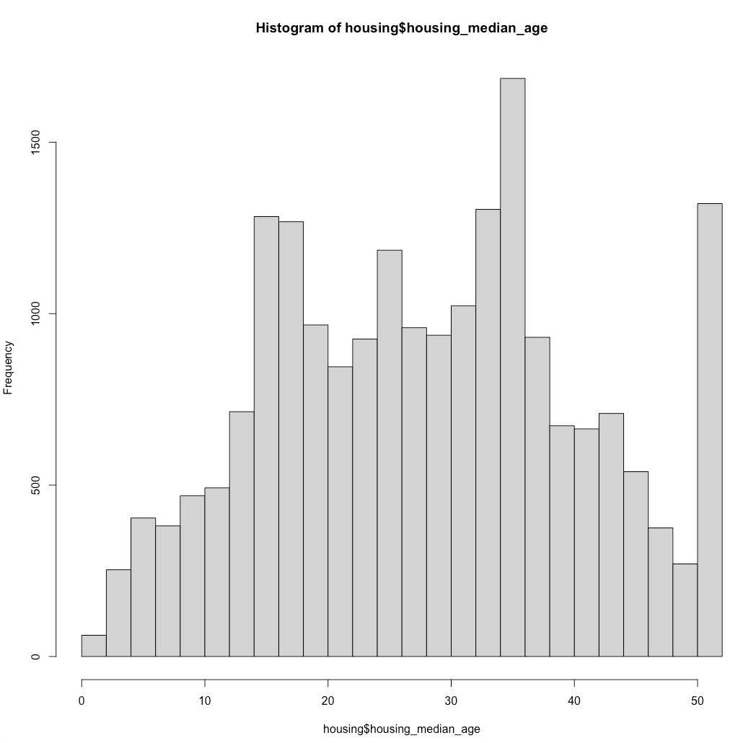
Let’s do the same for more statistics

Slide 13
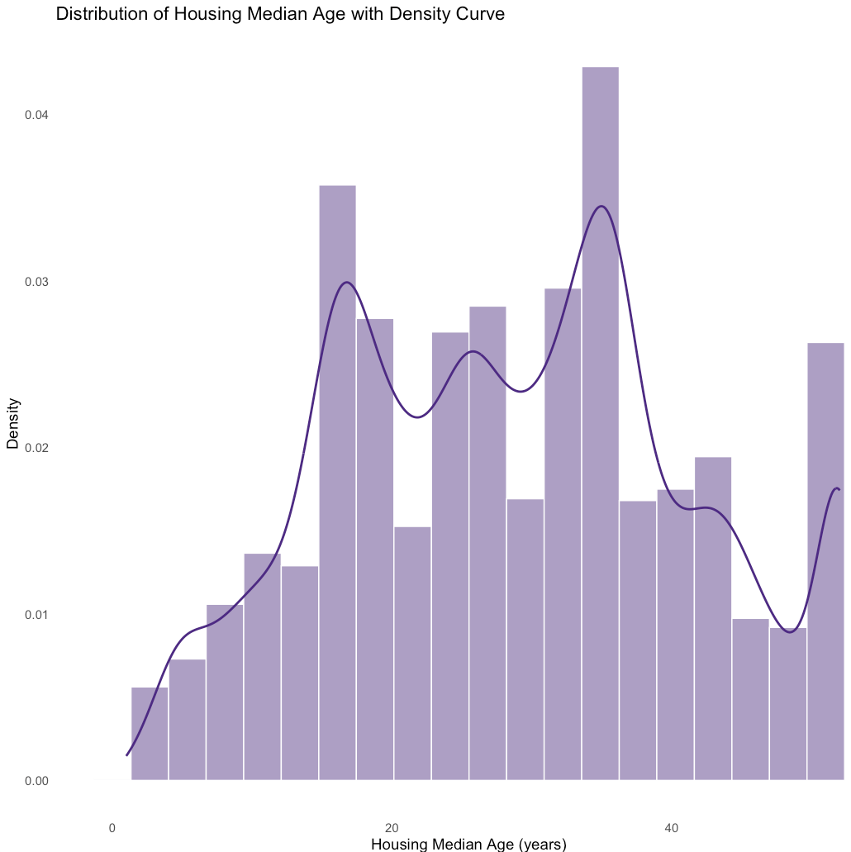
Let’s do the same for more statistics

Slide 14
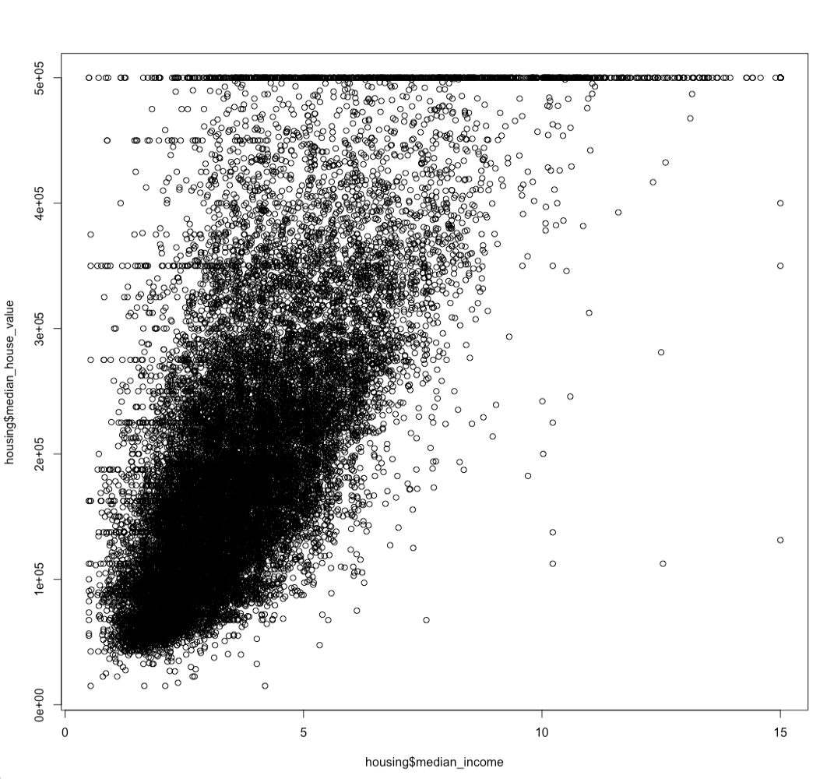
Let’s do the same for more statistics

Slide 15
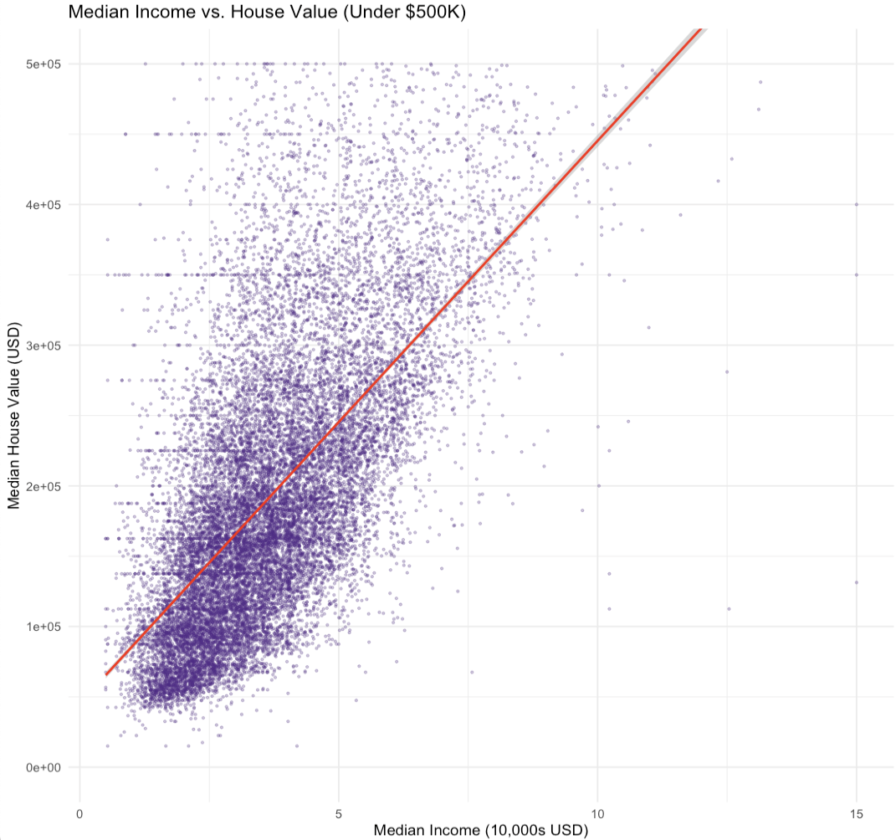
Let’s do the same for more statistics

